Slide 1
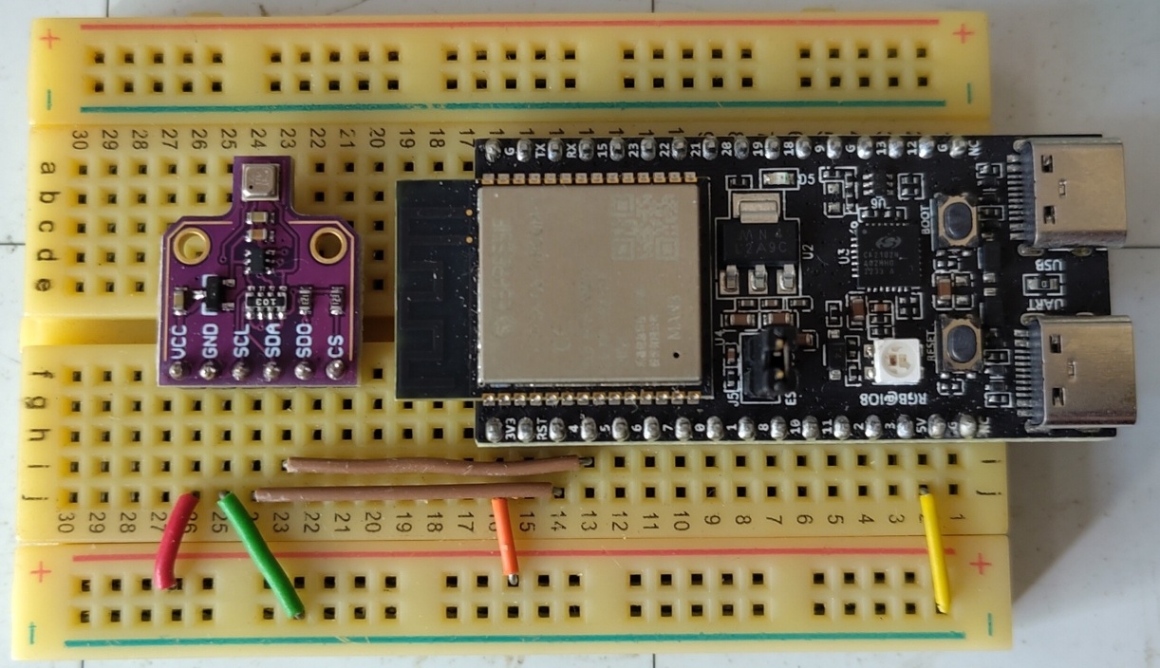

Experimenting with Embedded Swift on ESP32-C6 and I²C sensor
iOS Dev Scout (23 July 2025)
By: Yeo Kheng Meng (@yeokm1)
https://github.com/yeokm1/swift-embed-experiment

Slide 2


Who am I?
Yeo Kheng Meng
Embedded Security Researcher
Centre for Strategic Infocomm Technologies (CSIT)
MINDEF Technical Agency
10 years Embedded experience in private and public sectors
PCB Hardware Design
Microcontroller Firmware
Embedded Linux

Slide 3
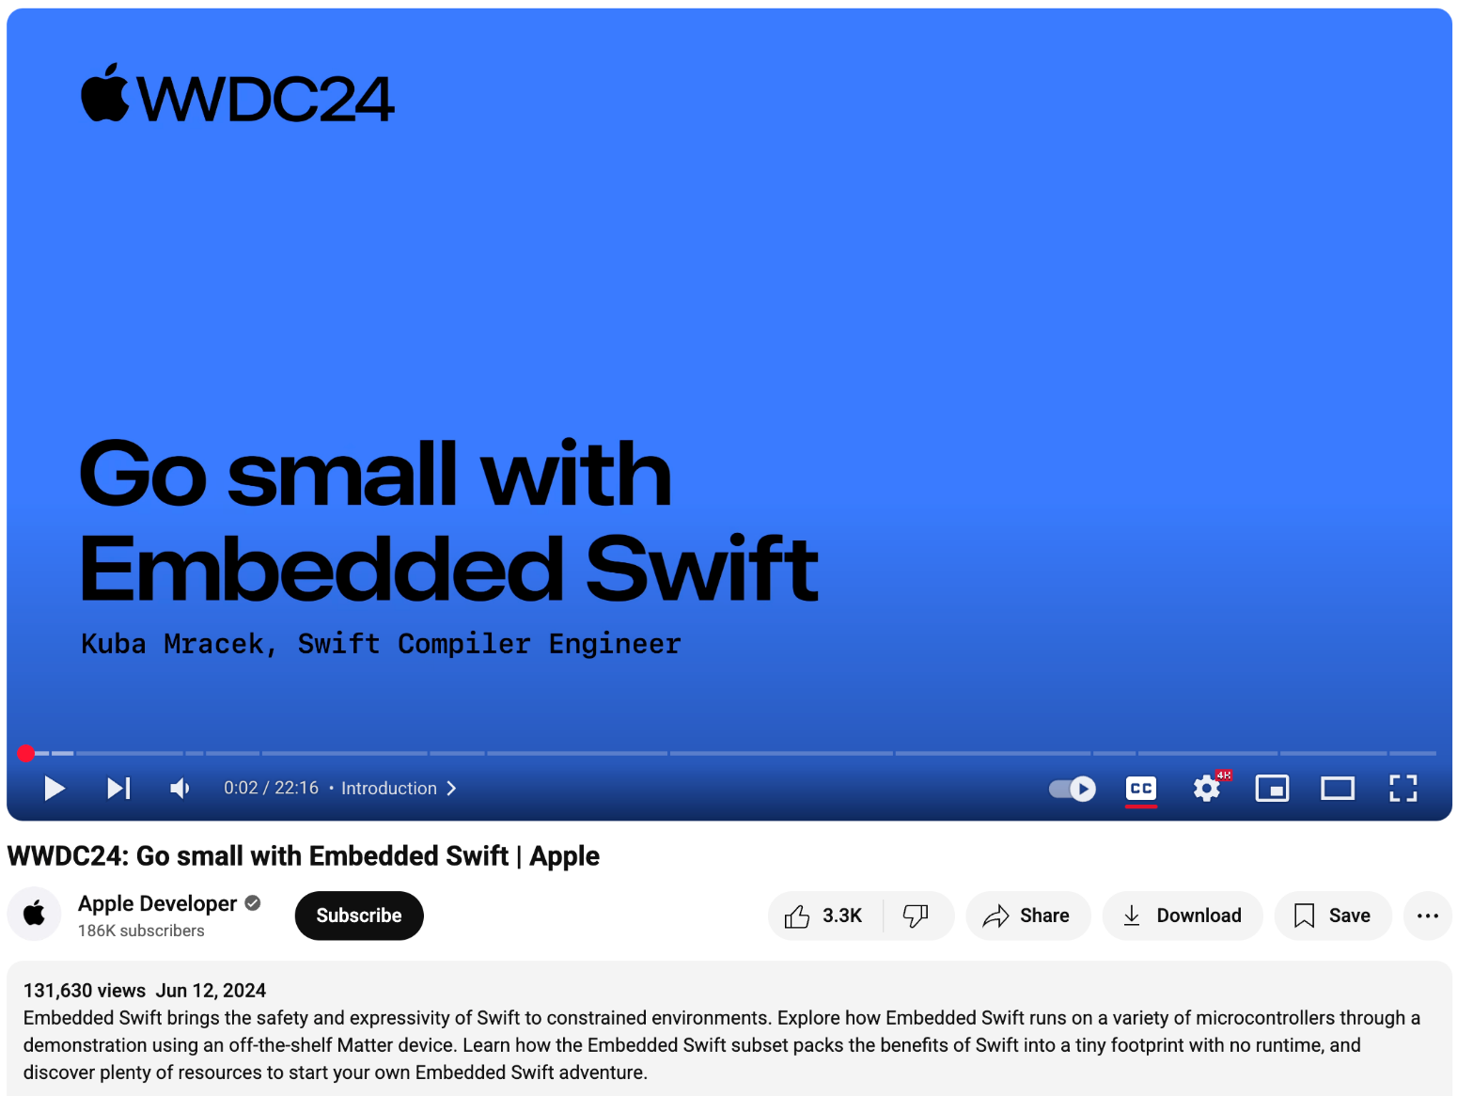
What is Embedded Swift?
First announced in WWDC 2024: https://www.youtube.com/watch?v=LqxbsADqDI4
Swift for resource-constrained microcontrollers like ESP32, RPi Pico, STM32

Slide 4
Before and after Embedded Swift
Before
Swift binary needs an operating system: iOS, MacOS, Linux, Windows
Runs on relatively performant hardware
GHz-class multi-core CPUs
GBs of RAM
GBs to TBs storage
After
Bare-metal microcontrollers (MCU) with no OS or relatively-small real-time OS
Resource-constraint hardware
Mhz-class single/dual-core CPU
Kilobytes to low Megabytes RAM
Kilobytes to low Megabytes storage

Slide 5
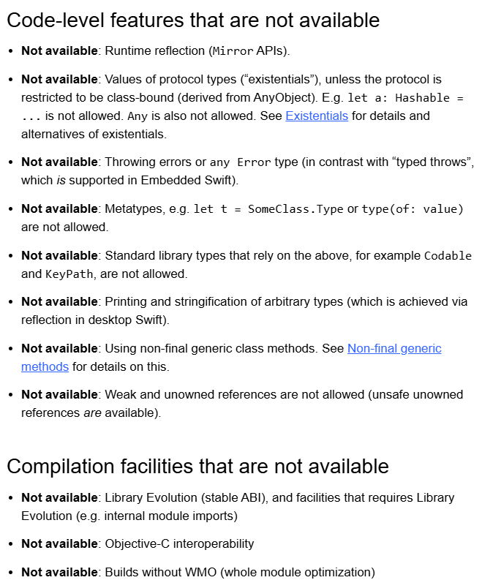
Embedded Swift vs conventional Swift
Experimental support
Subset of conventional Swift
>>>>>>>>>>>>>>>>>>>>>>>>>>>>>>>>>>>>>>
No Foundation
No print and String floating-point support
Xcode IDE does not support Embedded Swift
BridgingHeader.h
To import C SDK or libraries
No support for Objective-C
https://docs.swift.org/embedded/documentation/embedded/languagesubset/
https://github.com/swiftlang/swift/blob/main/docs/EmbeddedSwift/EmbeddedSwiftStatus.md

Slide 6
Presentation Topics
Hardware
Running Apple’s Embedded Swift example
Communicating with an environmental sensor
Using LLMs to aid in this project
Challenges encountered
Personal conclusion on Embedded Swift

Slide 7
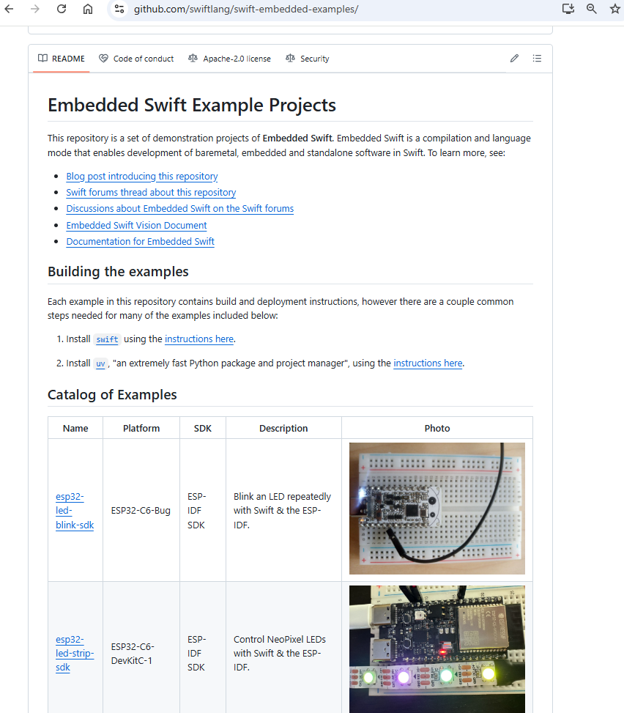
Board selection
Only a few MCU types are supported
Consult Swift Embedded examples Github
https://github.com/swiftlang/swift-embedded-examples/
Supported MCUs
Espressif ESP32-C6
Raspberry Pi Pico 1/2 (W)
Nordic nRF52840
STM32F746G
Why ESP32-C6-DevKitC-1?
Relatively low-cost SG$15
Pi Pico is cheaper at SG$6 but troublesome for development
Need to press BOOTSEL button on every flash
Requires separate SG$20 debug probe for ease of development

Slide 8
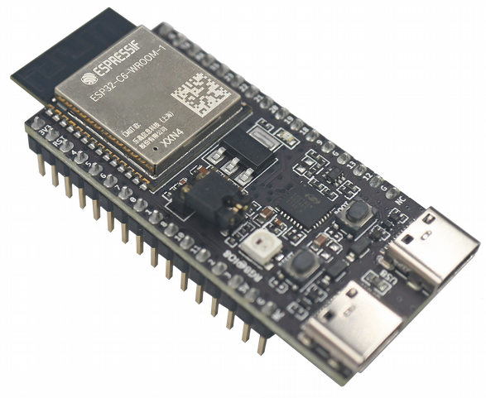
ESP32-C6-DevKitC-1 development board
Created by Espressif systems
Using ESP32-C6-WROOM-1 module
Onboard WS2812 RGB LED
USB-C Ports
Native USB Debug/Serial port
UART-USB through Silicon Labs CP2102

Slide 9
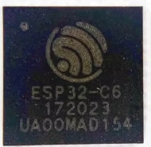
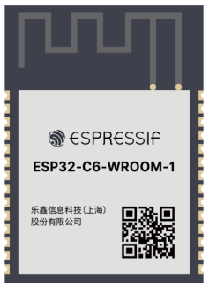
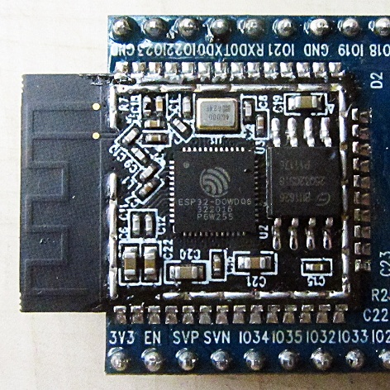
Hardware breakdown
ESP32-C6-DevKitC-1 (breakout board)
ESP32-C6-WROOM-1 Module
ESP32-C6 Quad Flat No-leads (QFN-40)
ESP32-C6-WROOM-1 module used to speed up hardware development
Flash options: 4/8/16MB
ESP32-C6 microcontroller specs
Dual-core RISC-V, LP: 20Mhz, HP:160Mhz
SRAM, LP: 16KB, HP: 512 KB
2.4Ghz Wi-Fi 6, Bluetooth 5
SPI, I2C, UART, GPIO

Slide 10
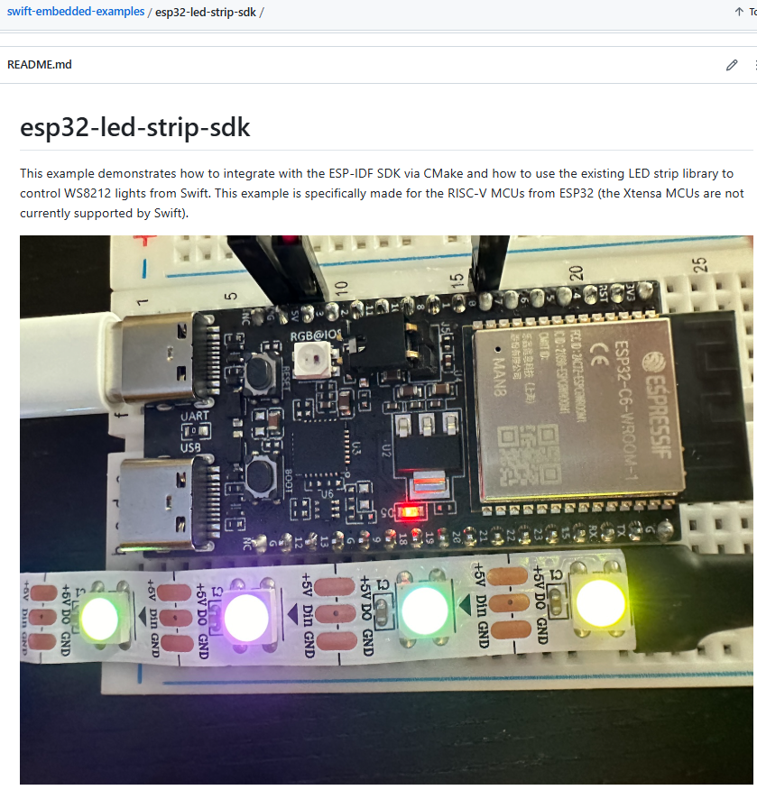
Using Apple’s lightstrip example
Light strip made of multiple WS2812 RGB LED
WS2812 uses single-wire daisy-chain protocol
Cycles through different colours
Install Swift development snapshot
brew install swiftly
swiftly install --use main-snapshot
swiftly list
Install ESP-IDF:
git clone -b v5.4.2 --recursive https://github.com/espressif/esp-idf.git
cd ~/esp/esp-idf
./install.sh esp32c6

Slide 11
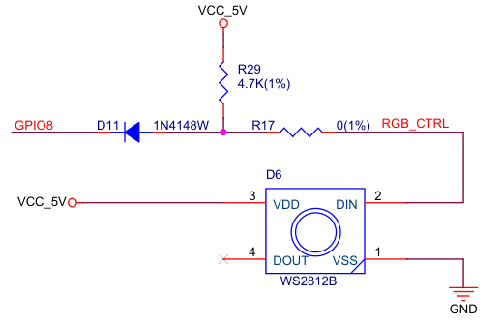
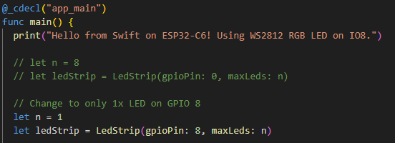
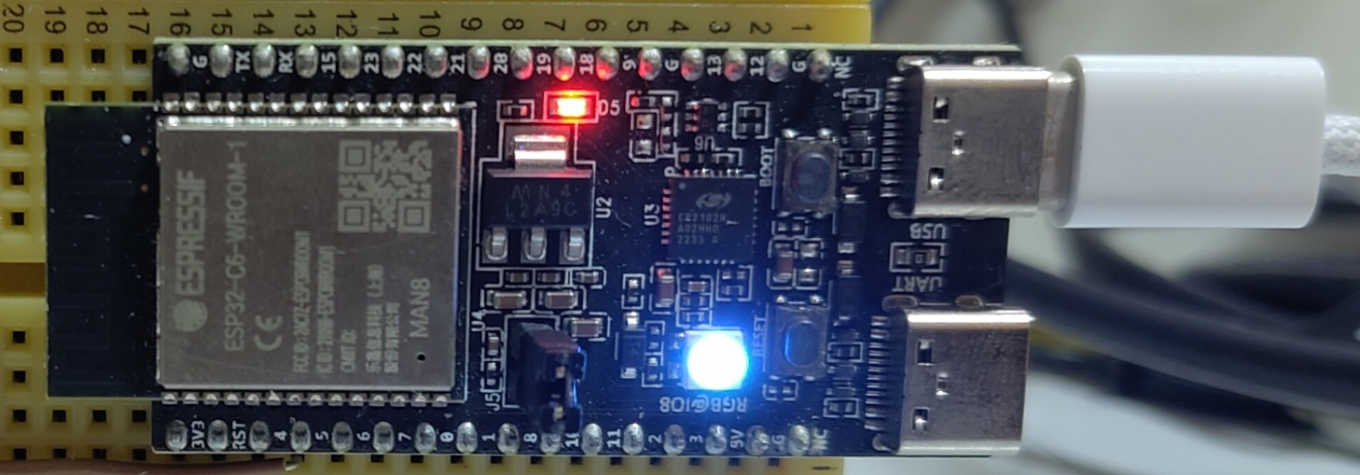
Modify example to use onboard RGB LED
Modify example
cd esp32-led-strip-sdk
Change to IO8
Build project by invoking MCU’s SDK
. $HOME/esp/esp-idf/export.sh
idf.py set-target esp32c6
idf.py build
idf.py flash
idf.py monitor

Slide 12
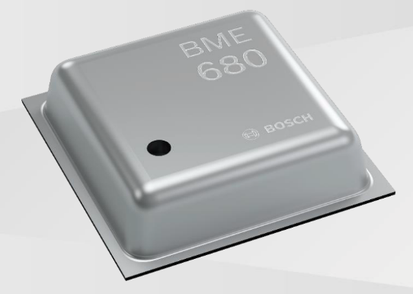
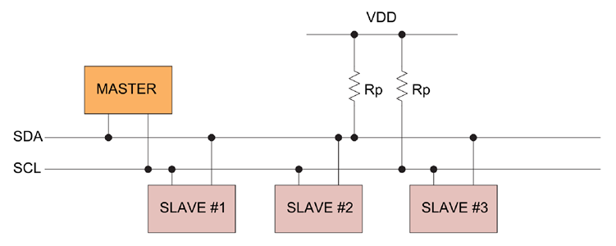
Bosch BME680 Sensor
Temperature, Pressure, Humidity, Gas sensor
3.0 x 3.0 x 1 mm
Connection: I2C, SPI
I²C - Inter-Integrated Circuit bus
Intra-board communication
2-wire protocol
Serial data line (SDA)
Serial clock line (SCL)
One master – multiple slave
Typical speed: 100kbps (standard), 400kbps (fast)

Slide 13
Asking LLMs – ChatGPT + Claude + Copilot
LLMs could not generate satisfactory Swift code for this purpose
Observations of LLM-generated Embedded Swift code
Swift code meant for iOS or MacOS
Provide empty functions for you to fill
Hallucination of none-existent embedded functions
Possible Reasons
Embedded Swift only released last year and still experimental
Majority of online Swift code is meant for iOS/MacOS
No official Apple examples of Embedded Swift ESP32 I2C communication
Embedded code is a niche field with less code online, mostly C/C++

Slide 14
Strategy
Suggested by ChatGPT
Write all Wrapper code in C
Avoid unsafe code and C data structures in Swift
Get Embedded Swift to call the C-wrapper code
Ask LLM to translate C wrapper code to Swift

Slide 15
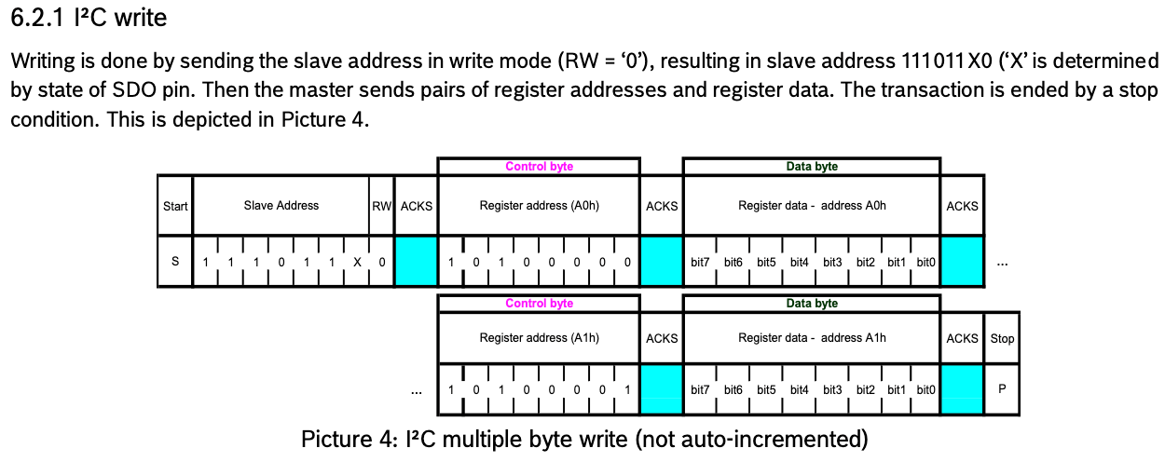
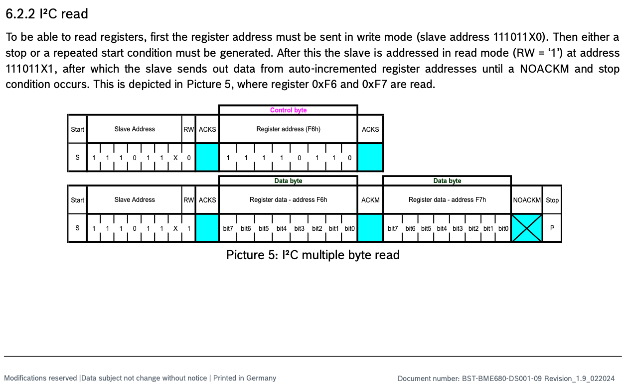
I2C Communication from BME680 datasheet
Master always initiates the communication
Data transfers usually works on registers
BME680 I2C Write register packet frame
Master writes slave address
Master writes register address (control)
Master writes data
Master sends STOP signal
BME680 I2C read register packet frame
Master writes slave address
Master writes register address (control)
Master sends STOP signal
Slave writes slave address
Slaves write data
Slaves sends STOP signal

Slide 16
Embedded I2C firmware flow
BME680 I2C library
int8_t bme68x_init(struct bme68x_dev *dev);
int8_t bme68x_get_data(uint8_t op_mode, struct bme68x_data *data, uint8_t *n_data, struct bme68x_dev *dev);
Function Pointers to provide in init:
int8_t (*bme68x_read_fptr_t)(uint8_t reg_addr, uint8_t *reg_data, uint32_t length, void *intf_ptr);
int8_t (*bme68x_write_fptr_t)(uint8_t reg_addr, const uint8_t *reg_data, uint32_t length, void *intf_ptr);
void (*bme68x_delay_us_fptr_t)(uint32_t period, void *intf_ptr);
Usually provided by manufacturers
Bosch BME680 I2C driver library
You have to implement I2C read/write and delay functions and pass to the library
Espressif Board Support Package (ESP-BSP)
API to use MCU hardware features
You have to develop
Bridge between the I2C driver and BSP
Call the necessary library/BSP functions
ESP-BSP
int i2c_master_transmit_receive(i2c_master_dev_handle_t i2c_dev, const uint8_t *write_buffer, size_t write_size, uint8_t *read_buffer, size_t read_size, int xfer_timeout_ms)
int i2c_master_multi_buffer_transmit(i2c_master_dev_handle_t i2c_dev, i2c_master_transmit_multi_buffer_info_t *buffer_info_array, size_t array_size, int xfer_timeout_ms);
void ets_delay_us(uint32_t us);
C-wrapper
Call BME680 init, pass your implement I2C read/write and delay function pointers
Call library get_sensor_data()
Library will use your implemented I2C read/write and delay functions

Slide 17
Embedded Swift compilation process
Swift code
C code
Swiftc
RISC-V GNU toolchain
Swift .o object code
C .o object code
ESP-IDF + ESP-BSP + linker
Binary

Slide 18
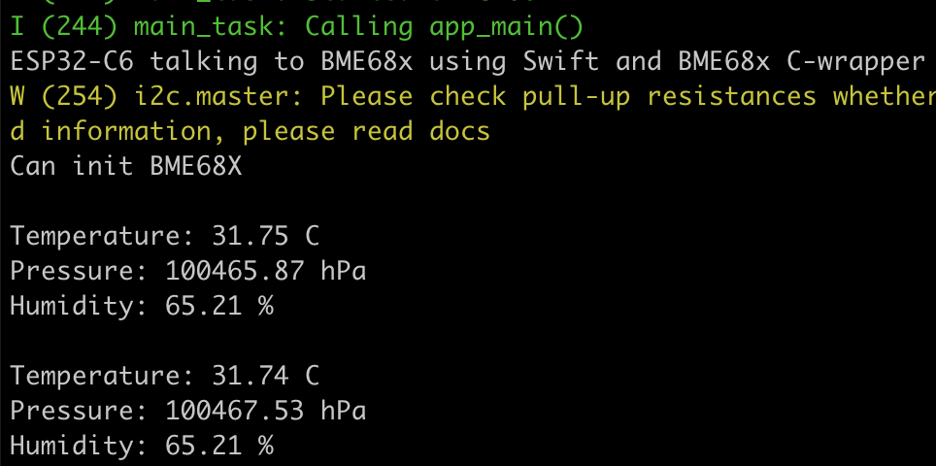
Demo of C-wrapper
cd esp32-bme680-c-wrapper
. $HOME/esp/esp-idf/export.sh
idf.py set-target esp32c6
idf.py flash && idf.py monitor

Slide 19
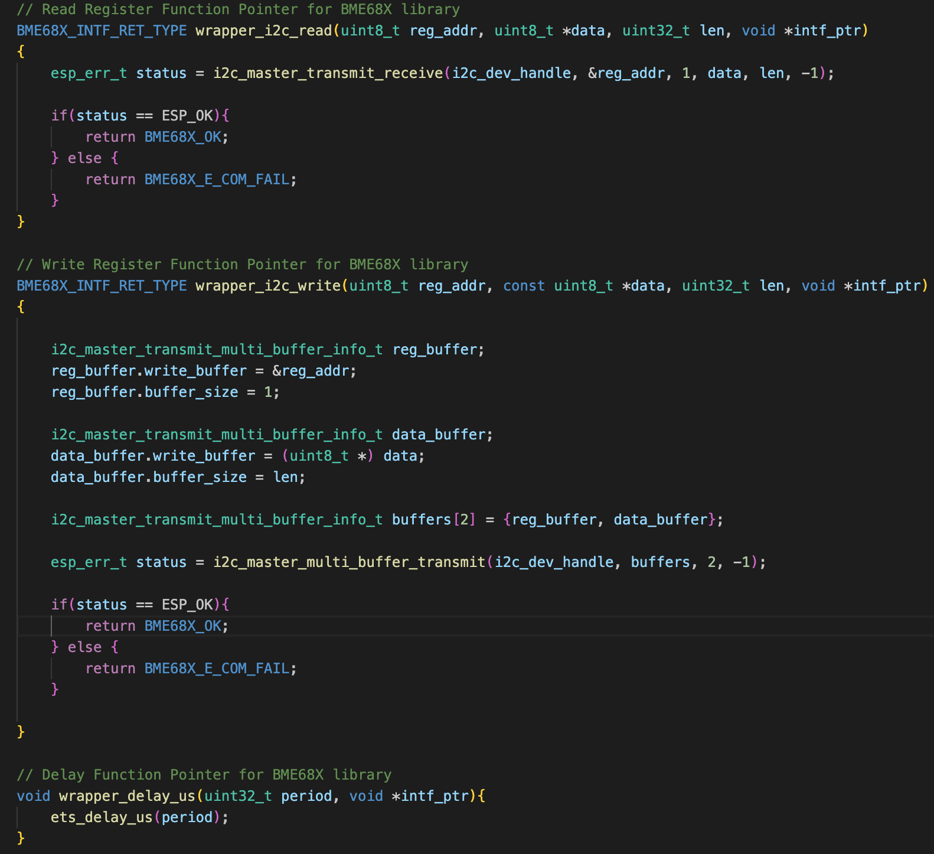
Implement C pointer functions using ESP-BSP
I2C read:
Passthrough to BSP i2c_master_transmit_receive()
I2C write:
Create array of i2c_master_transmit_multi_buffer_info_t
Send using BSP i2c_master_multi_buffer_transmit
Delay
Passthrough to BSP ets_delay_us(period);

Slide 20
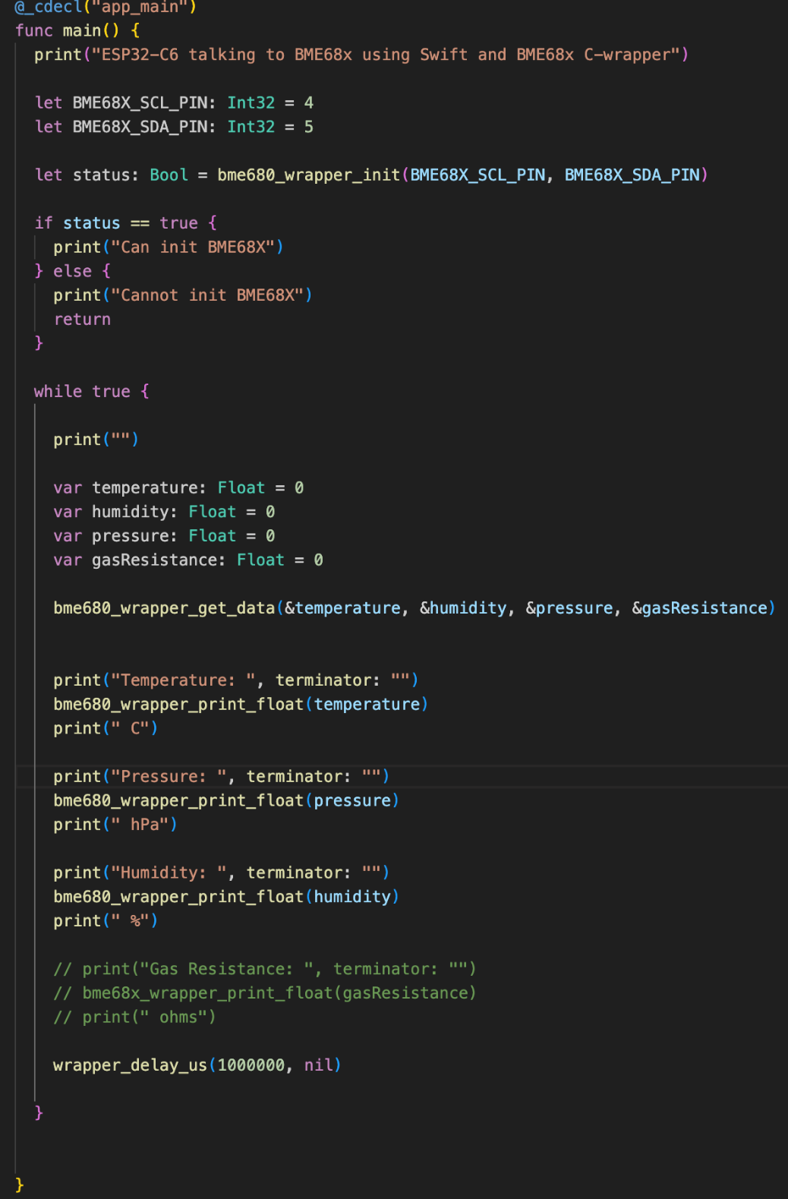
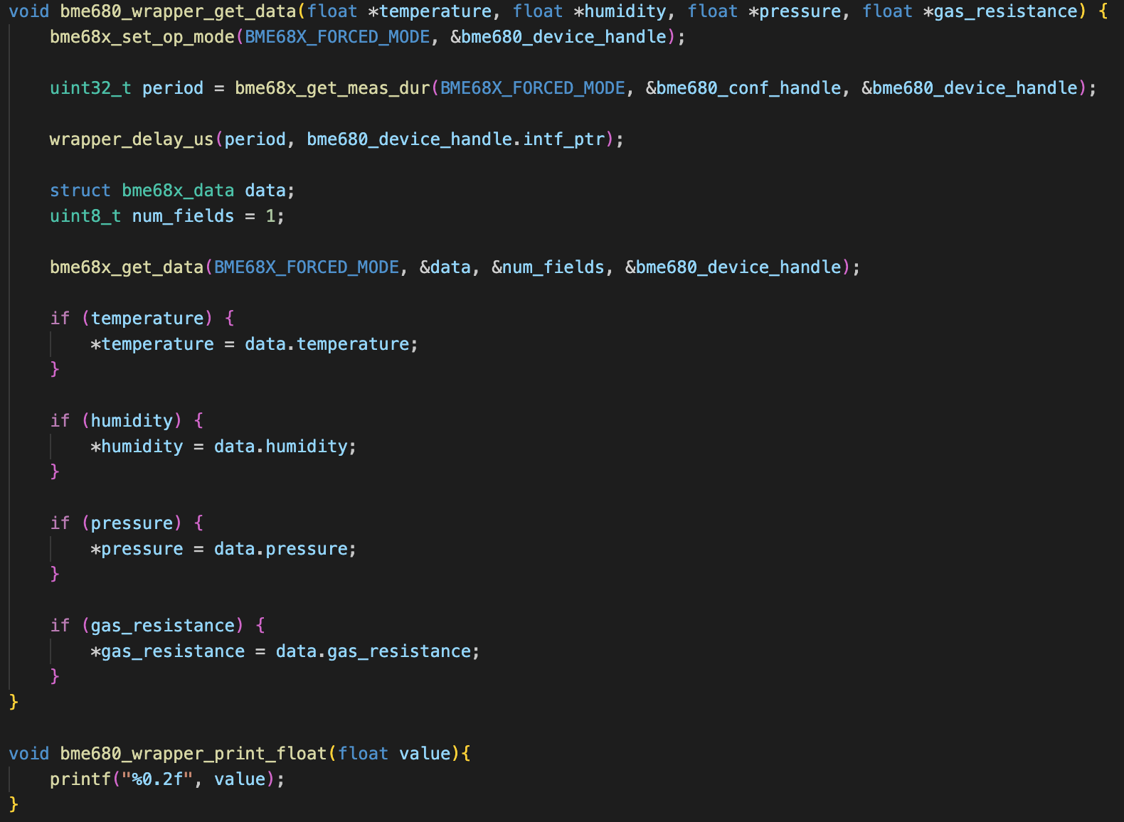
Swift calls C-wrapper
bme680_wrapper.c
Main.swift

Slide 21
Relevant C-Swift conversion
Calling C functions from Swift
Mapping C parameters to Swift Unsafe types
UnsafePointer<Type>, UnsafeMutablePointer<Type>
UnsafeRawPointer, UnsafeMutableRawPointer
https://developer.apple.com/documentation/swift/using-imported-c-functions-in-swift
Import C macros
“C macros that are more complex than simple constant definitions have no counterpart in Swift. ”
https://developer.apple.com/documentation/swift/using-imported-c-macros-in-swift

Slide 22
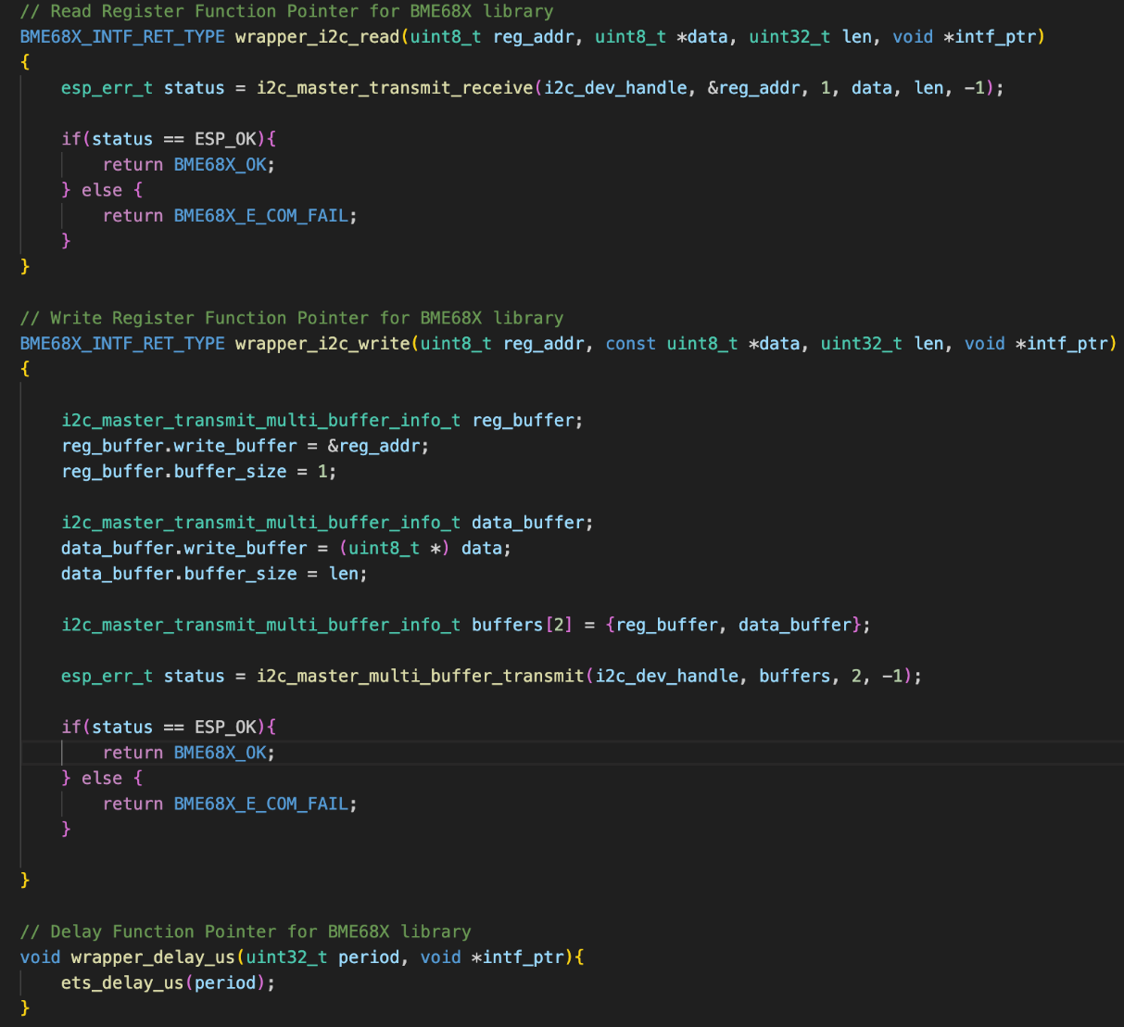
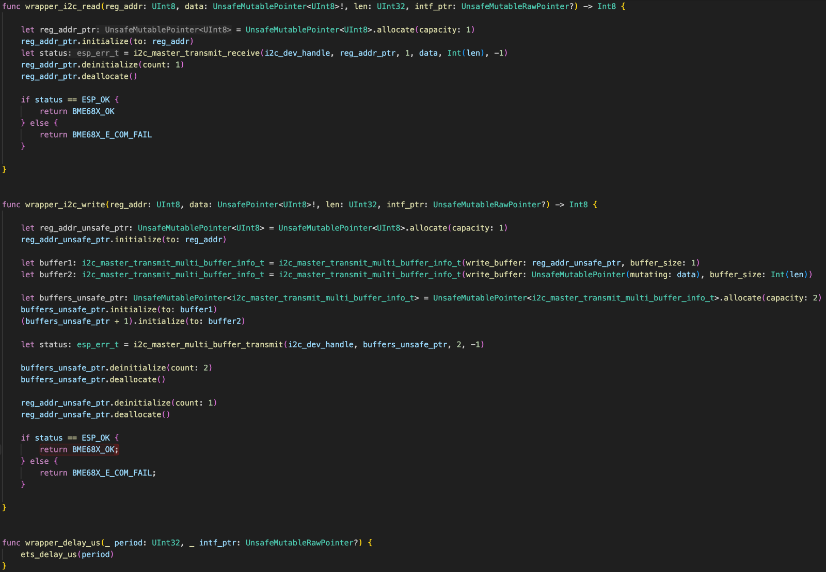
Translate pointer functions in C-wrapper to Swift-wrapper
bme68x_wrapper.c
bme68x_wrapper.swift

Slide 23
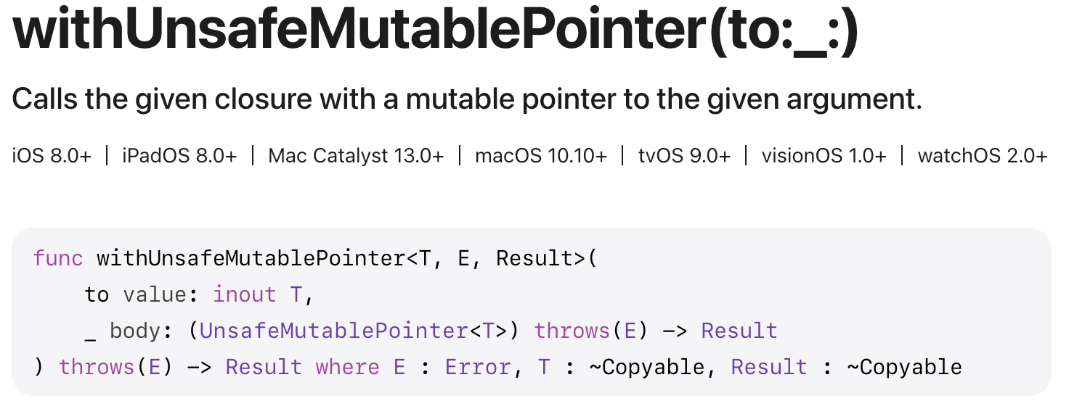
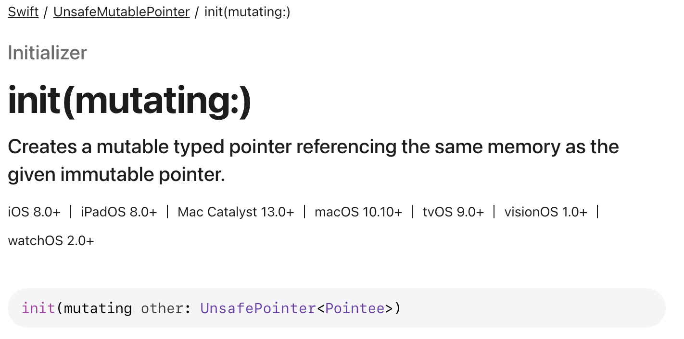
Avoiding direct use of UnsafeMutablePointer
UnsafeMutablePointer allocated on heap
Repeated allocation and deallocation on heap bad for MCUs
Slower
May cause memory fragmentation
Potential failure to allocate as memory resources limited on MCUs
Asked AI for a heap-less alternative
Use withUnsafeMutablePointer and mutating to temporarily access variables as UnsafeMutablePointer for duration of closure without heap allocation
https://developer.apple.com/documentation/swift/withunsafemutablepointer(to:_:)

Slide 24
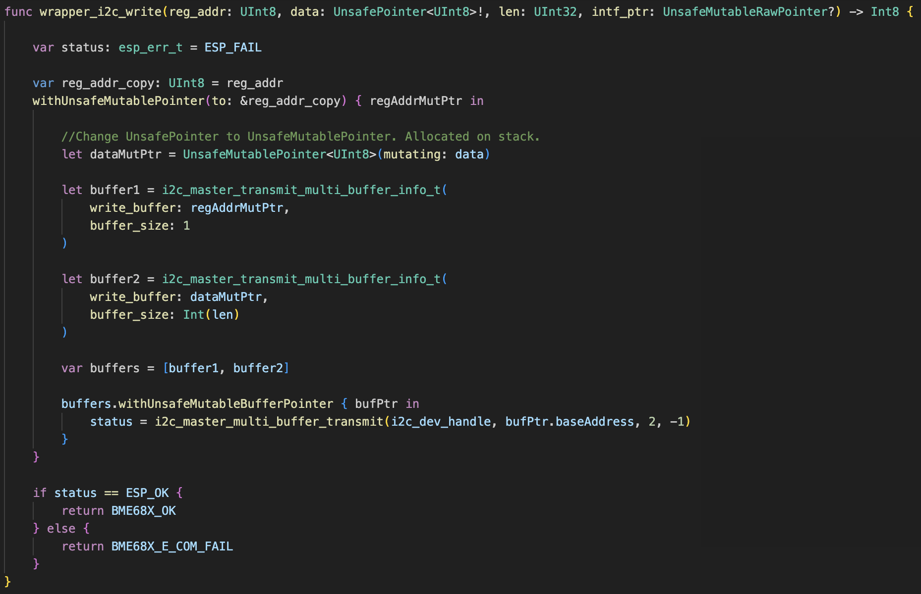
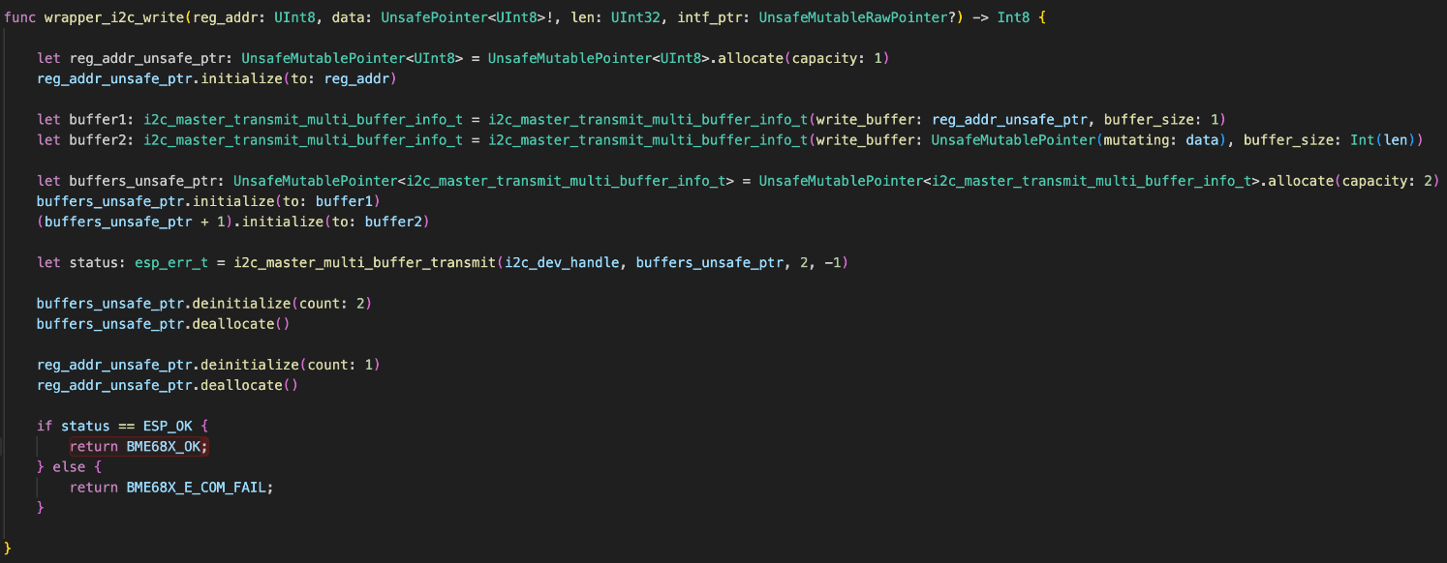
Heap-less option
Manually allocating UnsafeMutablePointer on heap
Scope withUnsafeMutablePointer

Slide 25
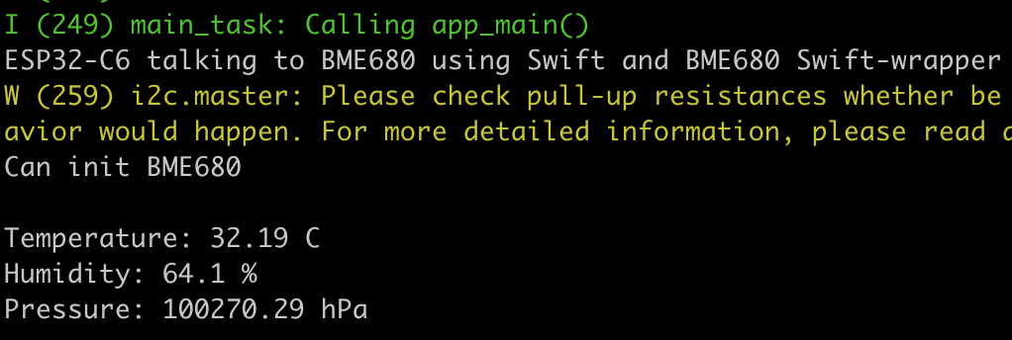
Demo of Swift-wrapper
cd esp32-bme680-swift-wrapper
. $HOME/esp/esp-idf/export.sh
idf.py set-target esp32c6
idf.py flash && idf.py monitor

Slide 26
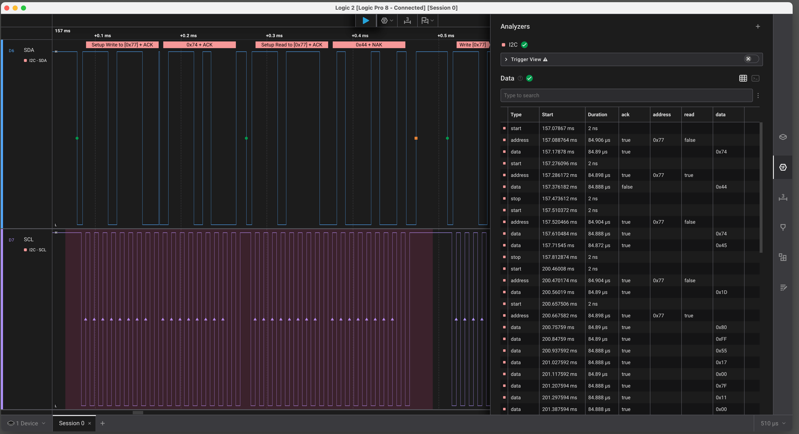
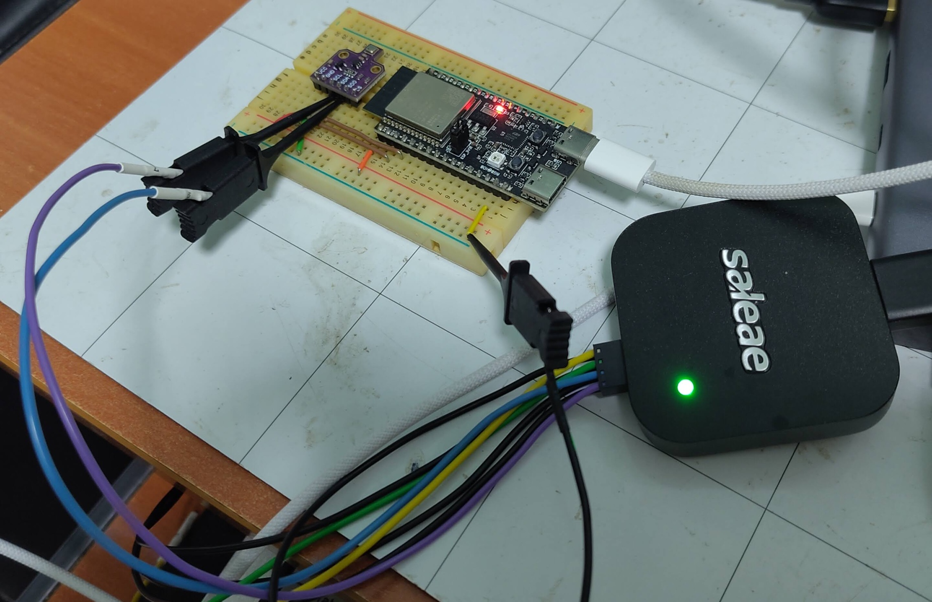
Troubleshooting with Logic Analyzer
Tapping I2C lines with Saleae Logic Pro 8
Reading and analyze signals with Logic 2

Slide 27
Conclusion
Embedded Swift still experimental after 1 year -> Not ready for production
Mismatch between goals of Swift (higher level languages) vs embedded platforms
High-level languages generally discourage using low-level features like UnsafePointers
Embedded engineers frequently use low-level access for performance/memory optimisation
Embedded devices are not as vertically integrated as Apple macOS/iOS devices
Heavy dependence on vendor stacks and C libraries
Not many MCUs are supported other than ESP32, RPi Pico, STM32
Most Embedded stuff are aimed at C/C++
SDK and Debugging tools
Documentation
-> Swift adoption by MCU embedded engineers would be very challenging

